Slide 1



Math You Can Touch,
Feel and Think.
Experiential Learning in Mathematics
From “I can't do math” to “I discovered it myself.”
Tactile
Curious
Discover

Slide 2

01 · THE BIG IDEA
What is Experiential Learning?
Learning by doing, reflecting, and applying in real situations.
1
EXPERIENCE
2
REFLECT
3
ABSTRACT
4
APPLY
TRADITIONAL
EXPERIENTIAL
Teacher explains → Student memorizes → Student practices
Student does → Student reflects → Student understands
02 / 12

Slide 3


02 · THE WHY
Why Math Needs Experience
Math is abstract. Symbols like 90° or ½ don't mean much until students experience them.
THE TEXTBOOK-ONLY PROBLEM
EXPERIENTIAL MATH BUILDS
Rote memorization without understanding
Math feels disconnected from real life
Fear and anxiety around the subject
Conceptual understanding that lasts
Real problem-solving skills
Confidence and curiosity
03 / 12

Slide 4

03 · THE FRAMEWORK
Kolb's Cycle in a Math Classroom
A real classroom example: students measure their classroom.
1
CONCRETE EXPERIENCE
2
REFLECTIVE OBSERVATION
Students measure the classroom using their footsteps.
“Why did my friend get 15 steps and I got 18?”
3
ABSTRACT CONCEPT
4
ACTIVE EXPERIMENTATION
Introduce the idea of standard units like the meter.
Measure again using a 1-metre rope and compare results.
04 / 12

Slide 5
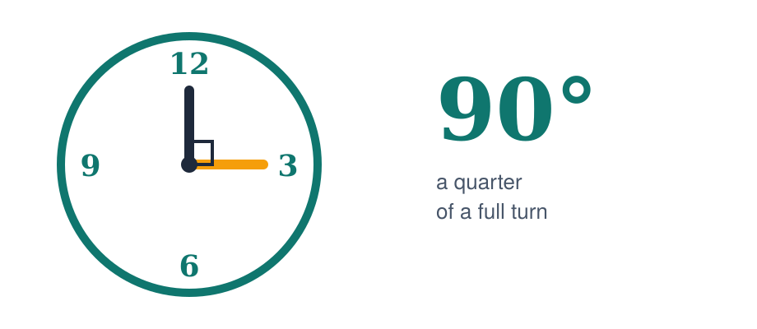
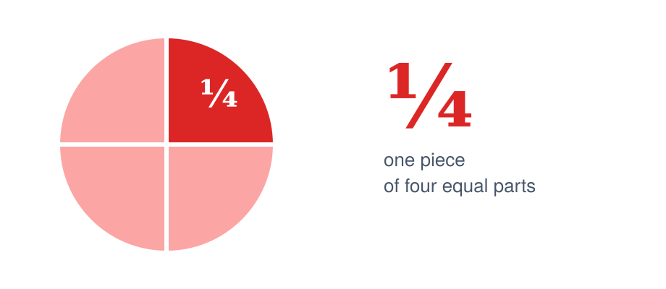
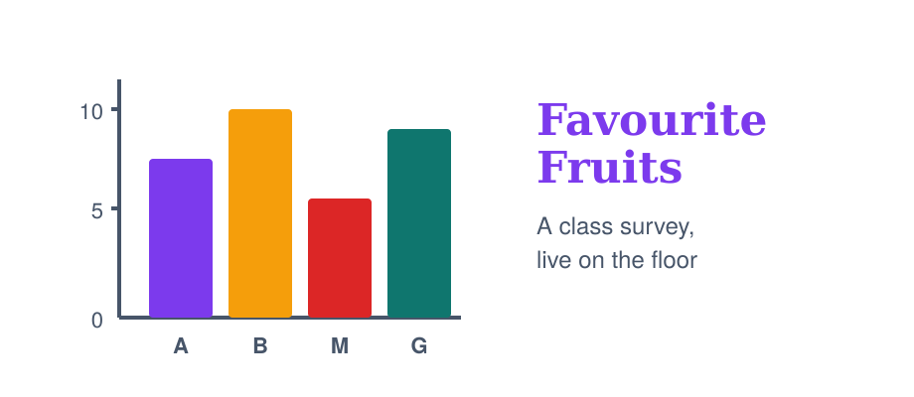
04 · IN PRACTICE
Three Examples from Primary Math
CLASS 5 · ANGLES & TURNS
CLASS 4 · FRACTIONS
CLASS 5 · DATA HANDLING
Make a 90° with your arms
Cut, fold, compare
A bar graph on the floor
Skip the textbook definition. Have students form a right angle using their own arms, then explore quarter, half and full turns on a real clock face.
Cut an apple or roti into equal parts to introduce ½ and ¼. Then ask students to fold paper to show ⅓ versus ¼ — and notice which piece is larger.
Collect data on “favourite fruit in class.” Then build a real bar graph on the classroom floor using coloured paper strips one strip per student.
05 / 12

Slide 6



05A · EASY WINS
Three for Shape & Space
Each one needs almost nothing, just things already in the room.
CLASS 4–5 · ANGLES
Open the classroom door to make 45°, 90° and 180°. Compare each angle with your arms same shape, just bigger.
The Door Trick
CLASS 1–3 · SHAPES
5-minute hunt: spot 3 rectangles, 3 circles, 3 triangles in the room. Sketch each one in a notebook.
Shape Hunt
CLASS 3–4 · SYMMETRY
Fold a sheet of paper or a leaf. Where are the lines of symmetry — and how many can you find on a single shape?
Fold and Find
06 / 12

Slide 7



05B · EASY WINS
Three More for Measure & Rhythm
These work even better as warm-ups before the textbook comes out.
CLASS 4–5 · PERIMETER
Wrap a string around a textbook, then straighten it out and measure with a ruler. That's the perimeter, in your hand.
String the Book
CLASS 3–5 · ESTIMATION
How many steps from your desk to the door? Estimate first, then walk and count. Whose guess was closest?
Guess the Steps
CLASS 1–3 · PATTERNS
Clap-stomp-clap-stomp. Can students extend it into ABAB or even ABCABC? Pattern recognition without a worksheet.
Clap, Stomp, Repeat
07 / 12

Slide 8




06 · YOUR ROLE
From Lecturer to Facilitator
Design with intent
Every activity has a clear math goal hidden inside it.
The teacher is not the lecturer.
Ask, don't tell
“What do you notice?” “What if we change this?”
You are the facilitator —
Allow productive struggle
designing the experience, then stepping back to let learning happen.
Let students wrestle with the problem before you intervene.
Bring it home
Connect the activity back to the underlying math concept.
08 / 12

Slide 9
07 · THE TRADE-OFFS
Benefits and Challenges
BENEFITS
CHALLENGES
Deeper understanding that lasts longer
Students see math in everyday life
Inclusive of different learning styles
Takes more time than textbook teaching
Classroom management during activities
Planning and material preparation
THE FIX
Start small. One 15-minute activity per chapter is enough.
09 / 12

Slide 10

08 · TRY IT TOMORROW
A 15-Minute Activity You Can Use
MULTIPLICATION · CLASS 4–5 · 15 MIN
The Shopkeeper Game
“You have ₹50. Buy 3 notebooks at ₹12 each. How much money is left?”
1
2
3
HANDLE
DECIDE
CONNECT
Students get fake currency and price cards.
They act out the purchase and count change.
Then write the multiplication: 3 × 12 = 36.
10 / 12

Slide 11

THE TAKEAWAY
Math + Meaning + Movement
When students experience math, it stops being a subject in the book — and becomes a tool they use to understand the world.
ONE QUESTION FOR THE ROOM
What's one topic your students find boring and how could you turn it into an experience?

Slide 12
THE END · AND THE START
Thank you.
QUESTIONS, IDEAS, STORIES — ALL WELCOME

